Slide 1
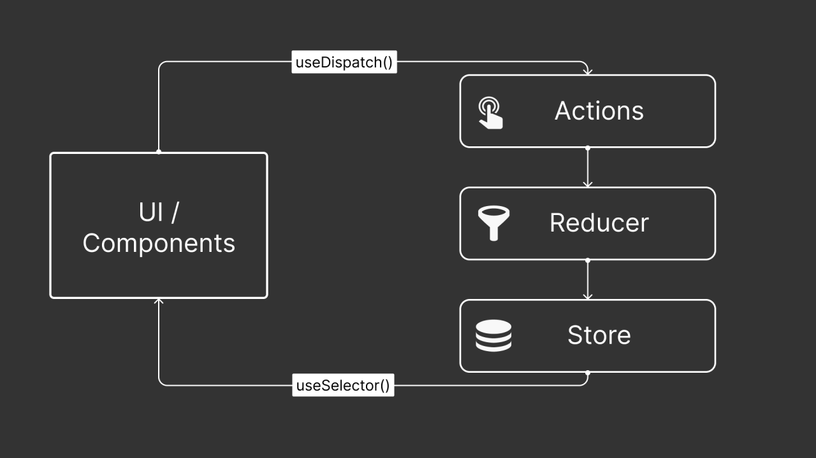
Redux Toolkit is a simplified and opinionated way to manage global state in large React applications.

Slide 2
User Interaction
↓
Dispatch
↓
Action
↓
Reducer
↓
Store (updated)
↓
Selector (reads data)
↓
UI Re-renders
1️⃣ Action
📌 What is an Action?
An action is a plain JavaScript object that describes what happened.
2️⃣ Reducer
📌 What is a Reducer?
A reducer is a function that:
Receives current state
Receives an action
Returns new state
It is the only place where state changes happen.
3️⃣ Store
📌 What is the Store?
The store is:
The central container that holds the entire app state.
Think of it as a database for your frontend.
4️⃣ Dispatcher
📌 What is Dispatch?
Dispatch is how you send an action to Redux.
5️⃣ Selector
📌 What is a Selector?
A selector reads data from the store.

Slide 3
Feature | Context API | Redux Toolkit
Built into React | ✅ Yes | ❌ No
Boilerplate | Low | Low (with RTK)
DevTools | ❌ No | ✅ Excellent
Middleware | ❌ No | ✅ Yes
Async logic | Manual | Built-in support
Performance at scale | Can degrade | Optimized
Best for | Small–medium apps | Medium–large apps

Slide 4
Criteria | Context API (React) | Redux Toolkit
What it is | Built-in feature of React | Official state management tool for Redux
Setup complexity | Very simple | Slightly more setup
Boilerplate | Low | Low (much reduced vs classic Redux)
Best for | Small to medium apps | Medium to large apps
Type of state | Simple global values | Complex, shared, business-critical state
Example use cases | Theme, Auth user, Language | Cart, Dashboard data, API-heavy apps
Performance | All consumers re-render on value change | Only subscribed components re-render
DevTools support | No built-in debugging tools | Powerful Redux DevTools
Async handling | Manual (useEffect, custom logic) | Built-in support (createAsyncThunk)
Middleware support | No | Yes
Scalability | Limited | Highly scalable
Team collaboration | Okay for small teams | Better for large teams
Learning curve | Easy | Moderate
Architecture structure | Flexible, less opinionated | Structured, predictable architecture

Slide 5
If your app is… | Use
Small & simple | Context API
Medium with growing complexity | Either (lean toward Redux if logic grows)
Large & production-level | Redux Toolkit
API-heavy with complex updates | Redux Toolkit
Just sharing theme or user info | Context API

Slide 6
{
products: { count: 0 },
user: { name: "John" }
} ------------------------------------------ 1️⃣ CartCount Component
const CartCount = () => {
const count = useSelector((state: RootState) => state.products.count);
console.log("CartCount rendered");
return <div>Cart Count: {count}</div>;
}; ------------------------------------------ 2️⃣ UserProfile Component
const UserProfile = () => {
const name = useSelector((state: RootState) => state.user.name);
console.log("UserProfile rendered");
return <div>User: {name}</div>;
};

Slide 7
🚀 Now Dispatch an Action
dispatch(addToCart());
This updates:
state.products.count += 1;
🔥 What Re-renders?
Component | Re-renders? | Why
CartCount | ✅ Yes | It subscribes to products.count
UserProfile | ❌ No | It subscribes to user.name (unchanged)

Slide 8
⚖️ Now Compare With Context
If both values were inside ONE context:
<AppContext.Provider value={{ count, name }}> If count changes: → ALL components using that context re-render → Even if they only use name
That’s the key performance difference.

